Slide 1
CSS 422 Hardware and Computer Organization
Introduction to Computer Architecture
Ver. 3
Professor: Munehiro Fukuda
This and subsequent slide deck includes a subset of Profs. Arnie Berger and Wooyoung Kim’s materials.

Slide 2
Topics
Preface: Course syllabus
Course objectives
Course work and grading
Policies
Lecture 1-1: Introduction to computer architecture
Von Neuman Architecture and the others
Levels of computing systems
Lecture 1-2: Data representation in computers
Number bases and inter-base conversions
Numbers in computers

Slide 3

Syllabus
From: https://www.lucidchart.com/blog/use-lucidchart-to-create-visual-syllabi

Slide 4
Course Objectives
This is an introductory course into..
Assembly Language Programming
Programming model of a microprocessor ( ARM Cortex-M )
Addressing modes
Writing in assembly language
Assembling, linking, loading, debugging
Interfacing (device-drivers, busses)
Computer memory system and transition to operating system
Memory hierarchy
Caches
I/O processes
Interrupts, Exceptions
The architecture of modern microprocessors
RISC vs CISC
Pipeline and performance (if time allows)
The fundamentals of digital hardware (digital logic and circuit design)
Concepts of gates, flip-flops, registers
Algorithmic State Machines
Data path and control flow (heart of a processor)
Introduction to microprocessors
Upper layer
Course work 1
Course work 4
Textbook Null
Course work 3
Course work 2
Lower layer

Slide 5
Course Work, Grading, and Policy
Course Work |  | %
Exams |  | 50
Project |  | 16.5
Participation | In-Class Lab, Exercises 0.5% x 19 sessions | 9.5
Homework (3% x 8 assignments) |  | 24
Total |  | 100
Achievements | Estimated Grade
95 – 100 | 4.0
90 – 94 | 3.5 - 3.9
80 - 89 | 2.5 - 3.4
70 - 79 | 1.5 - 2.4
62 - 69 | 0.7 - 1.4
Exams: open book
Project: to be done individually (but not in a group)
Submissions: Canvas only. No email submission
Make-up or late submission policy: sickness, family emergency (but not obligation), business/conference trips, and religious events
Regrading discussions: within 1 week after graded

Slide 6
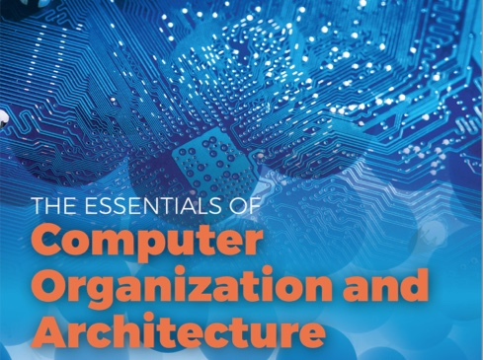
Intro to Computer Architecture
von Neuman
Instructions/data all non-distinguishably stored in memory
Harvard
Instructions and data separately accessed: e.g. I cache and D cache

Slide 7
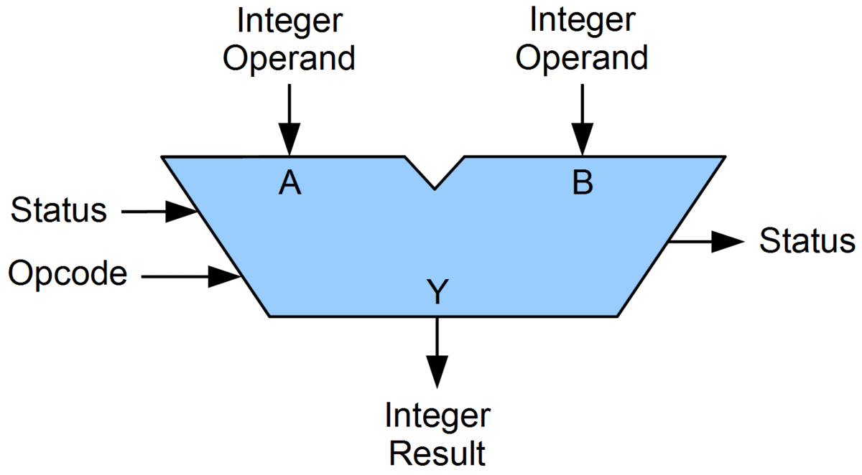
von Neumann Architecture
Memory
address
MAR
Data
data
ALU
MDR
Regs
PC
IR
Instruction
Essence: Everything (incl. instructions and data) in Memory

Slide 8
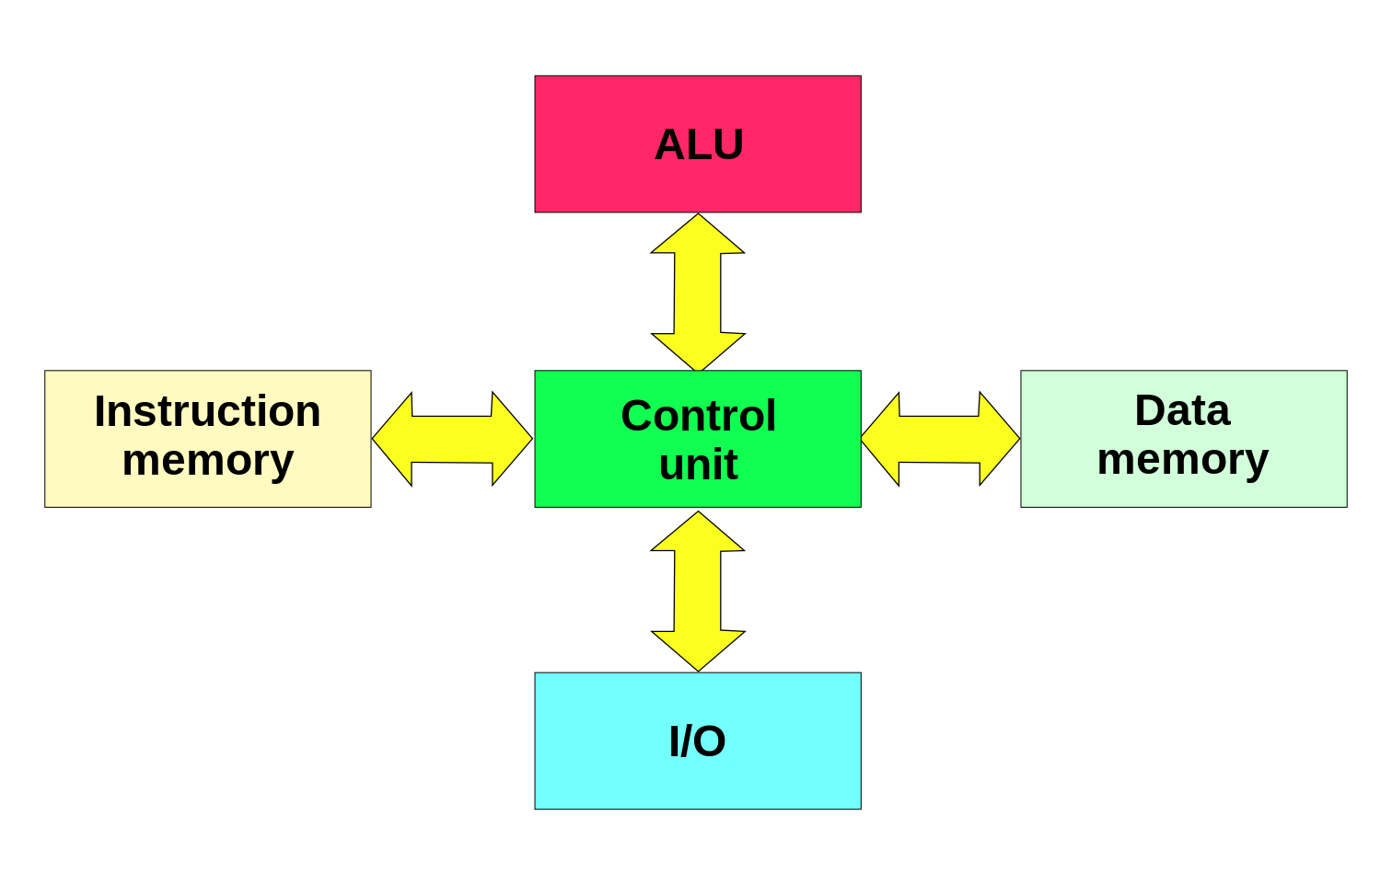
Harvard Architecture

Slide 9
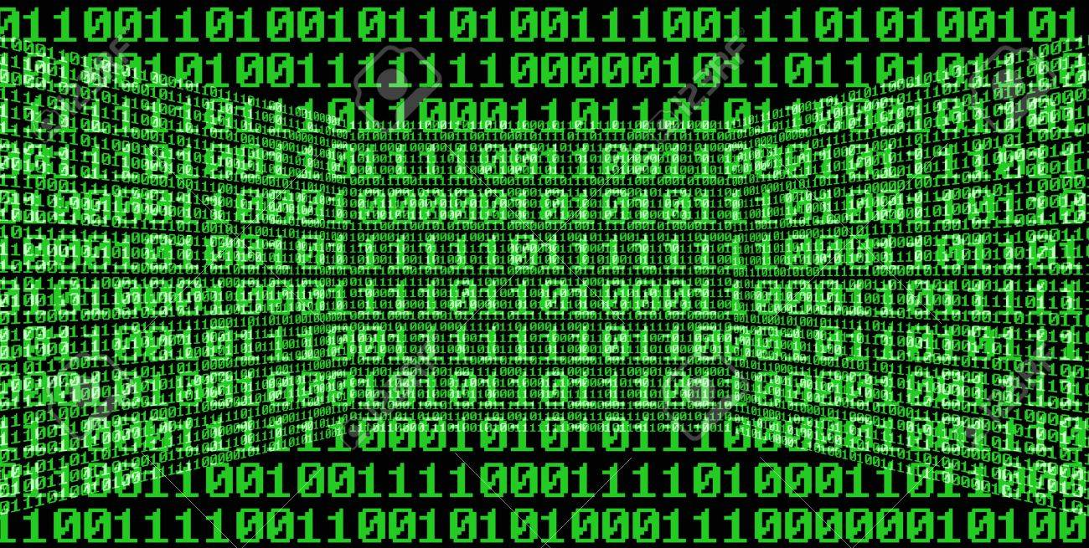
Data Representations
Why Binary?
Binary, octal, and hexadecimal
Bits, bytes, nibbles, words, and doubles
Giga, mega, kilo, milli, micro, nano
From: http://www.pages.drexel.edu/~nci27/binary-study-guide.html

Slide 10
Represent Data Value as Voltage
Approach #1 | Approach #2 | Apporach #3
along a single electrical conductor | along multiple electrical conductor | Along multiple, parallel, on-off electrical conductor
24.56345
4.2
RADIO
SHACK
RADIO
SHACK
2⁰
2¹
2²
2³
2⁴
2⁵
2⁶
2⁷
2⁸
2⁹
2¹⁰
2¹¹
2¹²
2¹³
2¹⁴
2¹⁵
on 1
off 0
on 1
off 0
off 0
on 1
on 1
on 1
off 0
off 0
off 0
on 1
on 1
on 1
on 1
off 0
24.56345 V
2
4
5
6
3
4
5
Zero volts
(ground)
Zero volts
(ground)

Slide 11
Binary Number System
Since we are switching between two voltage levels, our number system has only 2 digits, 1 or 0: a binary number system
The arithmetic and logical operations on a set of binary number is called Boolean Algebra
From approach #3, what is the number:
off on on on on off off off on on on off off on off on ?
0 1 1 1 1 0 0 0 1 1 1 0 0 1 0 1 ?
Answer: 30949
How did I get this?
0 x 2¹⁵ = 0 1 x 2¹⁴ = 16,384 1 x 2¹³ = 8,192
1 x 2¹² = 4,096 1 x 2¹¹ = 2,048 0 x 2¹⁰ = 0
0 x 2⁹ = 0 0 x 2⁸ = 0 1 x 2⁷ = 128
1 x 2⁶ = 64 1 x 2⁵ = 32 0 x 2⁴ = 0
0 x 2³ = 0 1 x 2² = 4 0 x 2¹ = 0
1 x 2⁰ = 1
16,384 + 8,192 + 4,096 + 2,048 + 128 + 64 +32 + 4 + 1 = 30949

Slide 12
Binary, Octal, and Hexadecimal
We use the binary number system to represent numbers and logical operations in a computer
Reading and writing binary numbers is tedious and error-prone because the numbers can be very long
Octal and hexadecimal are ways to simplify the representation of numbers to make them easier to understand and manipulate
For example:
0 1 1 1 1 0 0 0 1 1 1 0 0 1 0 1 = 30,949 in decimal
0 1 1 1 1 0 0 0 1 1 1 0 0 1 0 1 = 074345 in octal (074345 in C)
0 1 1 1 1 0 0 0 1 1 1 0 0 1 0 1 = 78E5 in hexadecimal (0x78E5 in C)
Notice how hexadecimal is the most compact way to represent the number
Notice how the binary numbers are grouped together in octal (by 3) and hexadecimal (by 4)
Question: when do you use octal or hexadecimal? Any examples?

Slide 13
Decimal to Other Bases
Algorithm:
Example: Convert 73,503 to base 16
73,503
16 4,593 ……… 15 (F)
16 287 ……… 1
16 17 ……… 15 (F)
16 1 ……….. 1
Therefore, answer is 11F1F₁₆
Why this algorithm?
11F1F = 1 * 16^4 + 1 * 16 ^3 + F * 16^2 + 1 * 16 + F
= ((((1 * 16) + 1) * 16 + F) * 16 + 1) * 16 + F
= ((17 * 16 + 15) * 16 + 1) * 16 + 15 = (287 * 16 + 1) * 16 + 15
= 4593 * 16 + 15 = 73503

Slide 14
Bits, Bytes, Nibbles, Words, …
Bit (1)
D3 D0
Nibble (4)
D7 D0
Byte (8)
D15 D0
Half Word (16)
D31 D0
Word (32)
D63 D0
Double, Long Long Int (64)
Very Long Instruction Word
D127 D0
VLIW (128)

Slide 15
Engineering Notation
In order to represent very large or very small numbers we usually resort to scientific notation:
For example: Avogadro’s Number = 6.023 x 10 ²³
Mantissa = 6.023, exponent = 23
It is common in engineering to use a shorthand version of scientific notation
Replacement values:
Symbol | Power | Symbol | Power
E: exa | 10¹⁸ | a: atto | 10^{–18}
P: peta | 10¹⁵ | f: femto | 10^{–15}
T: tera | 10¹² | p: pico | 10^{–12}
G: giga | 10⁹ | n: nano | 10^{–9}
M: mega | 10⁶ | μ: micro | 10^{–6}
K: kilo | 10³ | m: milli | 10^{–3}
Space
Hz
Time

Slide 16
Computers and Numbers
GB | MB | KB | B
2³⁰ = 1024MB = 1GB | 2²⁰ = 1024KB = 1MB | 2¹⁰ = 1024B = 1KB | 2⁰ = 1B
2³¹ = 2GB | 2²¹ = 2MB | 2¹¹ = 2KB | 2¹ = 2B
2³² = 4GB | 2²² = 4MB | 2¹² = 4KB | 2² = 4B
2³³ = 8GB | 2²³ = 8MB | 2¹³ = 8KB | 2³ = 8B
2³⁴ = 16GB | 2²⁴ = 16MB | 2¹⁴ = 16KB | 2⁴ = 16B
2³⁵ = 32GB | 2²⁵ = 32MB | 2¹⁵ = 32KB | 2⁵ = 32B
2³⁶ = 64GB | 2²⁶ = 64MB | 2¹⁶ = 64KB | 2⁶ = 64B
2³⁷ = 128GB | 2²⁷ = 128MB | 2¹⁷ = 128KB | 2⁷ = 128B
2³⁸ = 256GB | 2²⁸ = 256MB | 2¹⁸ = 256KB | 2⁸ = 256B
2³⁹ = 512GB | 2²⁹ = 512MB | 2¹⁹ = 512KB | 2⁹ = 512B

Slide 17
Summary
What components does a computer system have?
How does the computer represent numbers?
Convert decimal to any base numbers.
Convert any base numbers to decimal.
Binary, Octal, Hexadecimal number conversions.
What is the number of bits for byte, word and long word?
Express 0.00000002456 with scientific notation.

